Slide 1

3Ps
Parents & Pupils Portal
UX/UI CASE STUDY
An interactive school management application designed for students and parents to provide fast communication and easy tracking of students’ performance and checking of school-related information within a click away.
By: Rosh Hashana S. Torres
ENTER

Slide 2



TABLE OF CONTENTS
01. Project Overview
Page 3
02. Understanding
the User
Page 9
03. Starting
the Design
Page 18
Note: Buttons below are clickable.
04. Refining
the Design
Page 31
01
02
03
04

Slide 3
01.
PROJECT OVERVIEW
3
The Product
Project Duration
The Problem
The Goal
My Role
Responsibilities
01
02
03
04

Slide 4
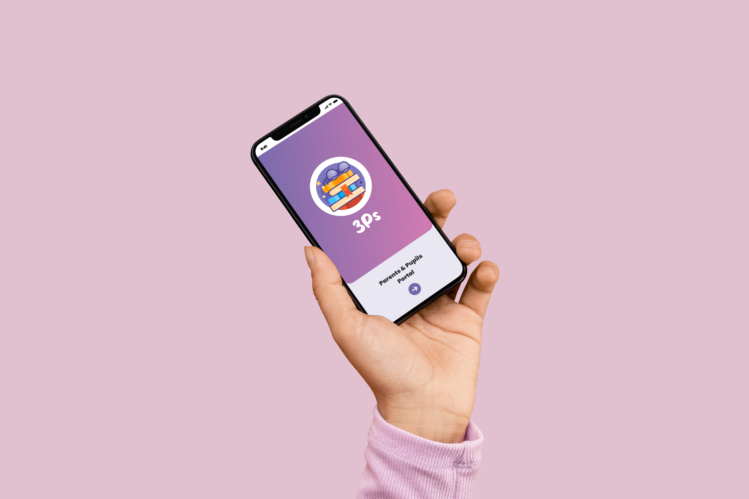

4
The Product
3Ps stands for Parents & Pupils Portal. It is an interactive school management application designed for students and parents to provide fast communication and easy tracking of students’ performance and checking of school-related information within a click away.
3Ps
Product Duration
Made with:
4 Months
August 2022 – December 2022
01
02
03
04

Slide 5
5
COLORS USED
#FFFFFF
#000000
#777777
#BDAEC6
#6F69AC
#CAB8FF
#6867AC
#CE7BB0
FONTS USED
Poppins
A geometric sans-serif typeface.
Milky Honey
A stylish, lovely and sweet font.
01
02
03
04

Slide 6
The school management application will be designed from scratch as the current one lacks a communication process, has an interface that makes it difficult for users to navigate the home dashboard, there was no organized student tracker for tracking student performance, and school-related information were inaccessible for students and parents to monitor.
6
THE PROBLEM
01
02
03
04

Slide 7
7
THE GOAL
Our school management application will let users track students’ performance and check school-related information. This will affect how the school connects with students and parents by giving them convenience to access relevant school-related information faster and easier. We will measure effectiveness by looking how frequent users utilize the application.
01
02
03
04

Slide 8
8
RESPONSIBILITIES
Identify and assess user requirements.
Illustrate design concepts using process flow, storyboard, and sitemap.
Design graphic user interface elements.
Create UI mockups and prototypes that demonstrate the functionality and appearance of the application.
MY ROLE
UX Designer for 3Ps (Parents & Pupils Portal) application from conception to final product.
01
02
03
04

Slide 9
02.
UNDERSTANDING THE USER
9
User Research:
Summary
Pain Points
Personas
Storyboard
01
02
03
04

Slide 10
My user research process consisted of conducting comparative analysis among the existing similar applications. The user research affirmed the initial assumption that the users experience difficulty in using the application due to its unorganized interface. The users also confirmed that the existing applications lack of other features.
10
USER RESEARCH: SUMMARY
01
02
03
04

Slide 11
USER RESEARCH: PAIN POINTS
11
Process
The existing applications do not have a tracker for students’ performance and school-related information is not accessible.
Product
The client needs a school management application with an organized student tracker for performance and a school-related information noticeboard for both students' and parents' monitoring.
Support
User feedback will be gathered during testing in order to solve pain points and highlight design problems.
01
02
03
04

Slide 12

Oliver Lopez
12
USER RESEARCH: PERSONAS
Goals
Access information about child and school
Keep track of child’s educational progress
Smooth communication between all the officials of the school
Pay fees in due time
Age: 38 years old
Occupation: Businessman
Location: Cebu City, PH
Frustrations
Problem Statement
Oliver, a businessman who is frequently away needs an application to easily track students’ performance and check school-related information because he lacks free time to visit his child’s school.
Has to visit school to check school-related information
Hard to track child’s regular reports and activities
Has no effective and efficient communication with the teachers
Faced problems attending parents-teacher meetings due to work schedule
01
02
03
04

Slide 13

Alice Zamora
13
USER RESEARCH: PERSONAS
Goals
Feel secure about the child’s safety
Keep track of child’s school vehicle
Age: 33 years old
Occupation: Housewife
Location: Quezon City, PH
Frustrations
Problem Statement
Alice, a housewife who is anxious needs an application to quickly track the routes of students’ transport vehicle because she is tensed about her child’s safety.
Tensed about the child’s safety
Does not have much time to accompany and fetch the child in school due to household chores
01
02
03
04

Slide 14

Noah Lim
14
USER RESEARCH: PERSONAS
Goals
Access to school notices anytime and anywhere
Stay tuned with all the essential information related to the assignment/project
Keep connected with the teachers
Age: 12 years old
Occupation: Student
Location: Manila, PH
Frustrations
Problem Statement
Noah, a student who is forgetful needs an application to keep track of school happenings and announcement because he always missed important updates.
Missing important information
Not updated and informed about the school notices
01
02
03
04

Slide 15
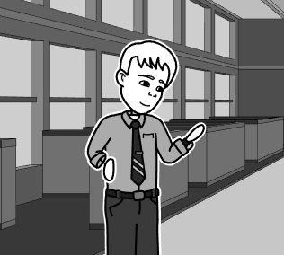
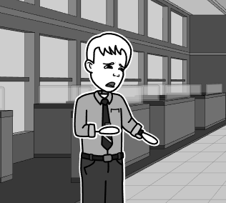
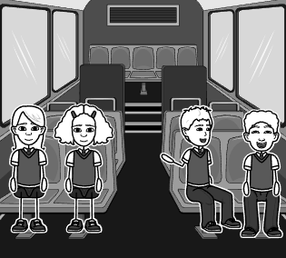
15
USER RESEARCH: STORYBOARD
A father who is frequently away from home due to business trips in another city decided to call his son to check how his school performance was so far.
He tried to call his son but to no avail, he wondered why he is not answering his phone.
The son did not notice that his father was calling since he was chatting with his seatmate on the school bus while on their way home.
01
02
03
04

Slide 16
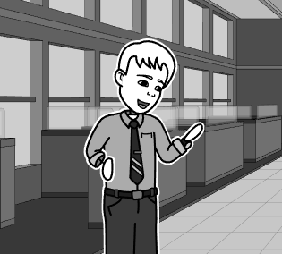
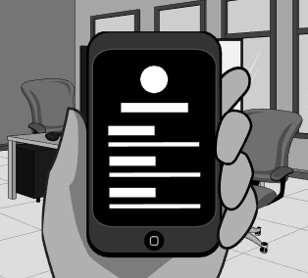
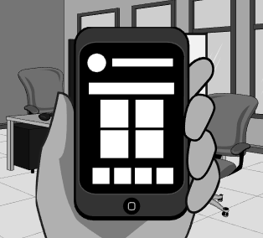
16
USER RESEARCH: STORYBOARD
The father suddenly remembered the school management application that was mentioned by his son.
He installed the application and created an account.
He logged in to the application and sees a list of menu options on the home screen.
01
02
03
04

Slide 17
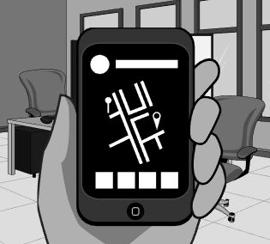
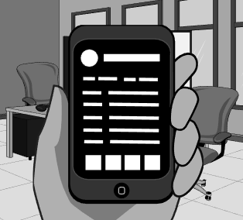
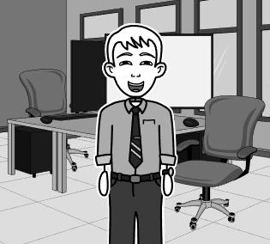
17
USER RESEARCH: STORYBOARD
He clicked the Transport option to track whether his son is home or not. He confirmed from the application tracker that his son is still on the way home
He continued to explore the application and clicked the Academic option. He filtered the previous grading period to check his son’s educational progress.
The father was happy to know his son is doing a great job. He also felt relieved knowing his son’s whereabouts.
01
02
03
04

Slide 18
03.
STARTING THE DESIGN
18
Flowchart
Sitemap
Persona-Based Task Flow
Paper Wireframes
Digital Wireframes
Low-Fidelity Prototype
Interaction Map
01
02
03
04

Slide 19
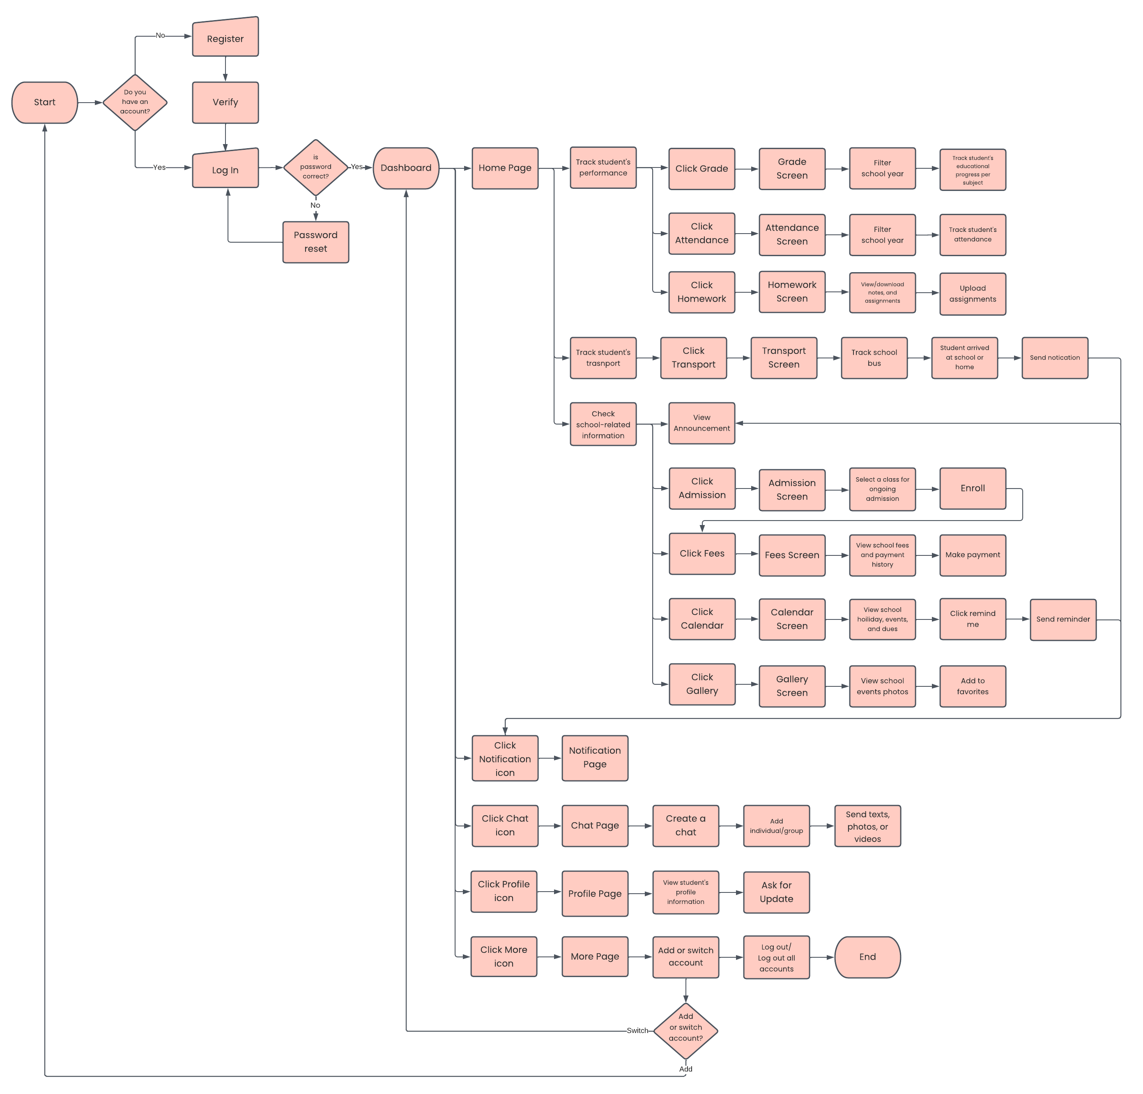
19
FLOWCHART
This is the flowchart showing the complete path a user takes when using this application.
For a clearer copy, please click here.
01
02
03
04

Slide 20
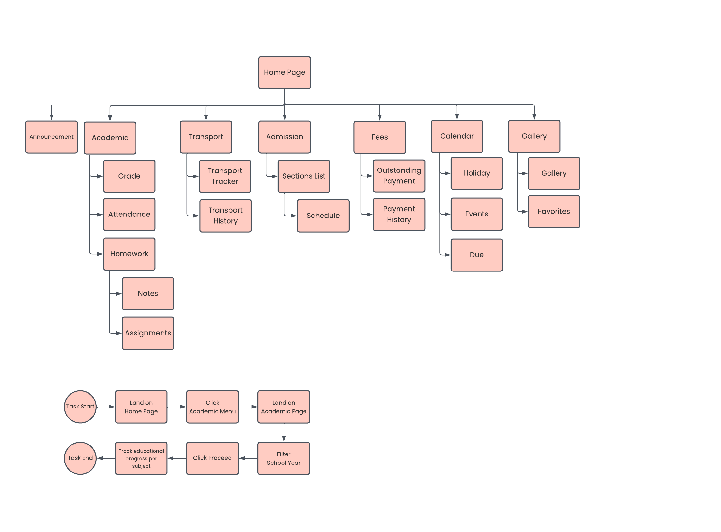
20
SITEMAP
This is the sitemap showing the structure, organization of pages, and content of this application.
For a clearer copy, please click here.
01
02
03
04

Slide 21
21
PERSONA-BASED TASK FLOW
This is the persona-based task flow diagram showing the user’s journey on tracking educational progress per subject.
01
02
03
04

Slide 22
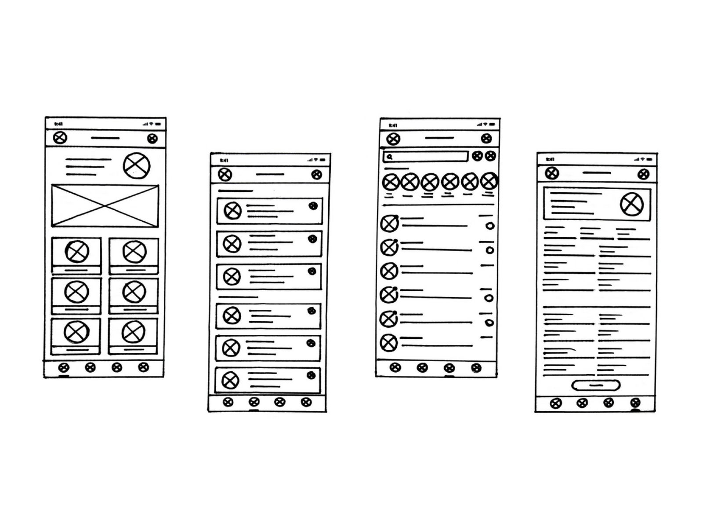

22
PAPER WIREFRAMES
This is the paper wireframes of 3Ps application. Paper wireframe is a sketch or drawing that represents the skeleton of the app interface.
01
02
03
04

Slide 23
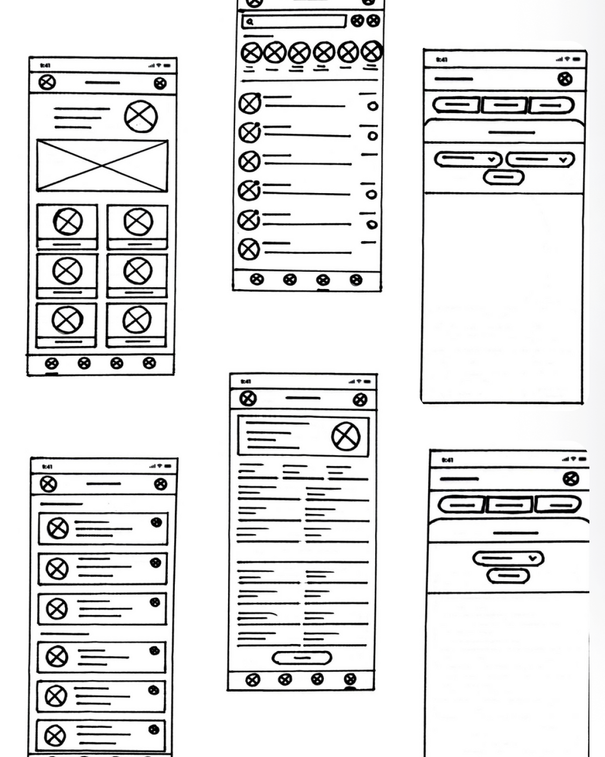
23
PAPER WIREFRAMES
01
02
03
04

Slide 24
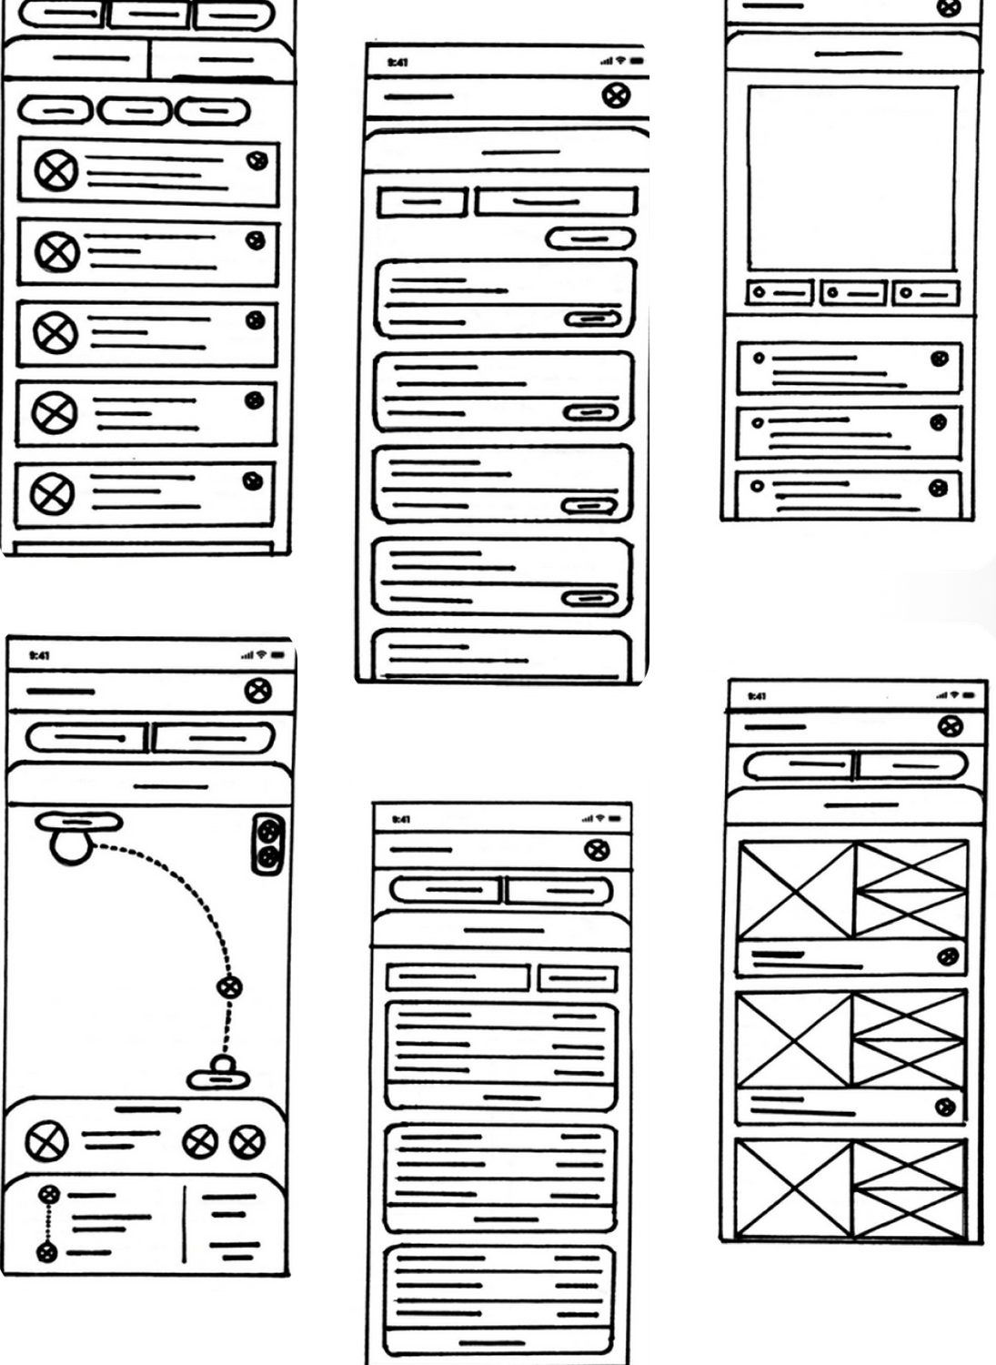
24
PAPER WIREFRAMES
01
02
03
04

Slide 25
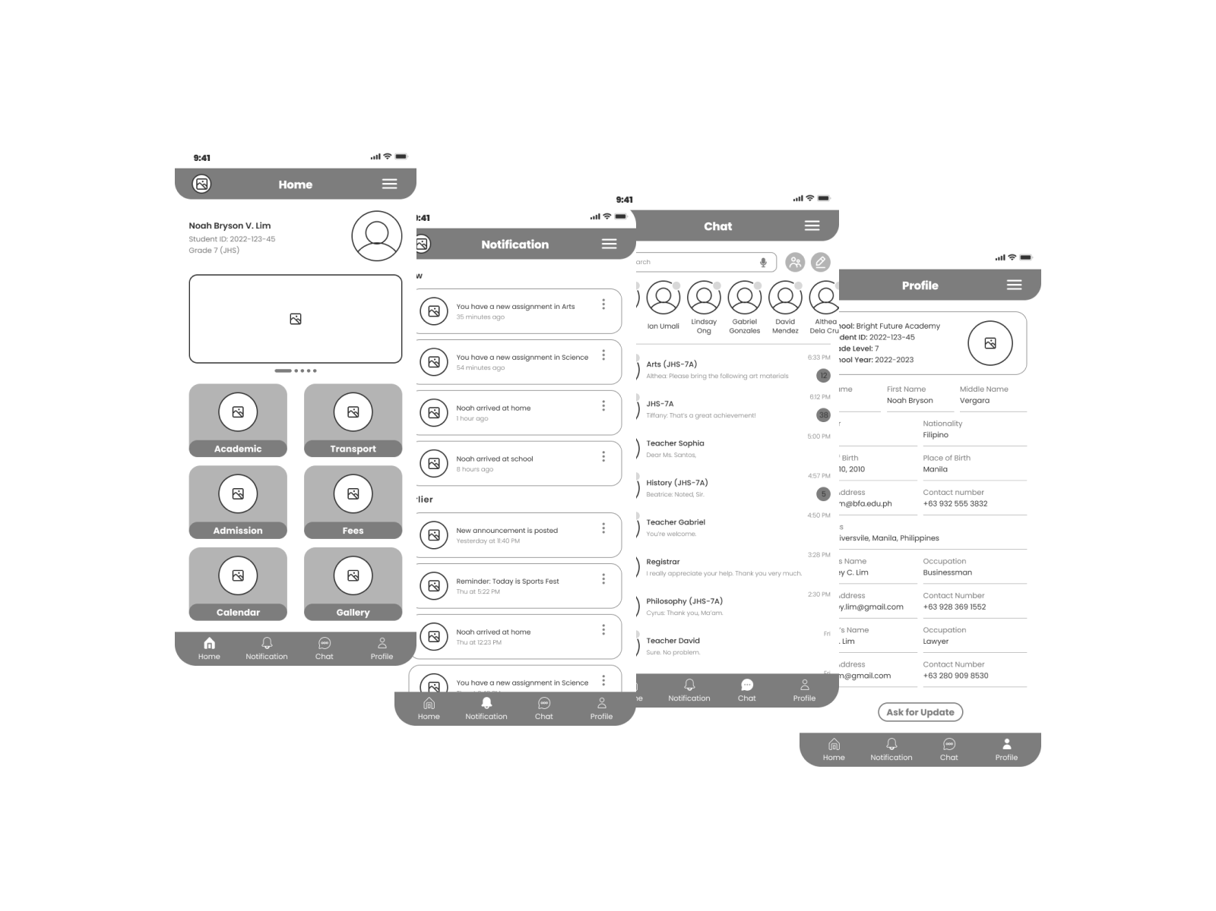
25
DIGITAL WIREFRAMES
This is the digital wireframes of 3Ps application. Digital wireframe is a basic, two-dimensional visual representation of the app interface.
01
02
03
04

Slide 26
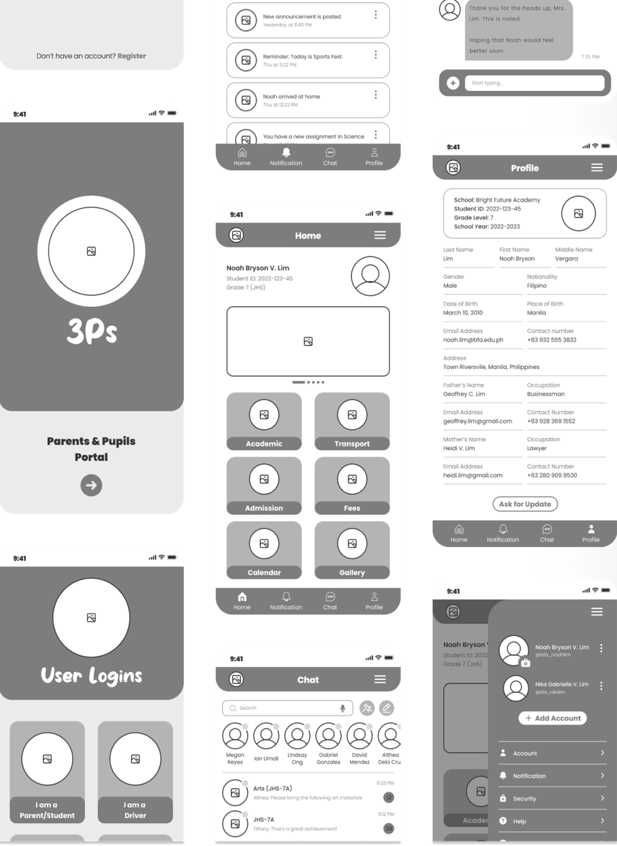
26
DIGITAL WIREFRAMES
01
02
03
04

Slide 27
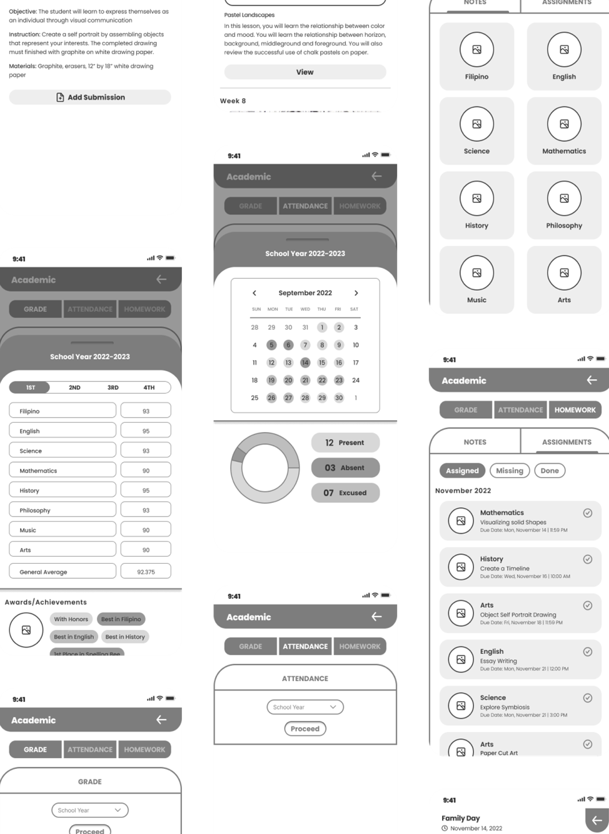
27
DIGITAL WIREFRAMES
01
02
03
04

Slide 28
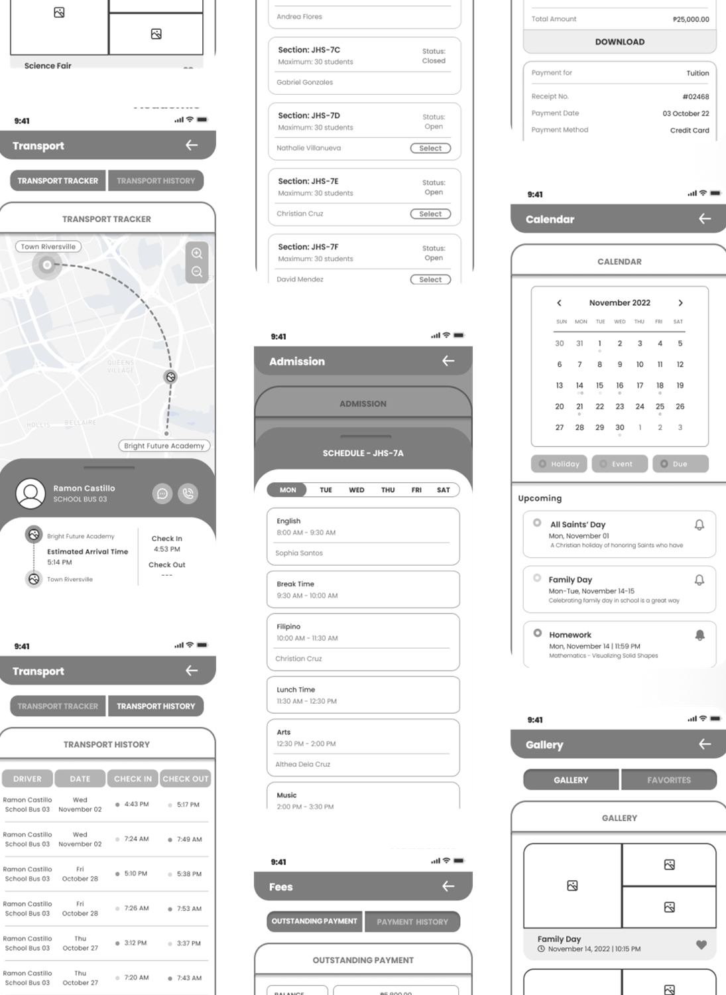
28
DIGITAL WIREFRAMES
01
02
03
04

Slide 29
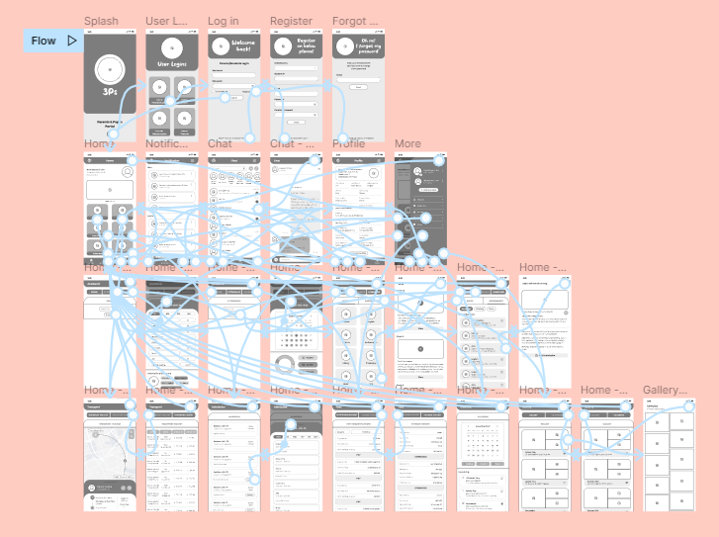
29
LOW-FIDELITY PROTOTYPE
This is the low-fidelity prototype showing the connections between each screen. A working prototype can be tested by clicking on the link here.
01
02
03
04

Slide 30
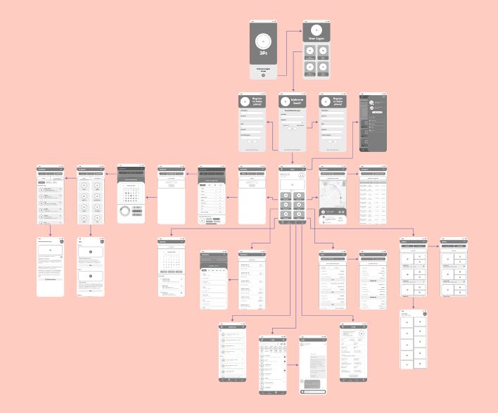
30
INTERACTION MAP
This is the interaction map showing the connections between each screen.
For a clearer copy, please click here.
01
02
03
04

Slide 31
04.
REFINING THE DESIGN
31
Mockups
High-Fidelity Prototype
Accessibility Considerations
01
02
03
04

Slide 32
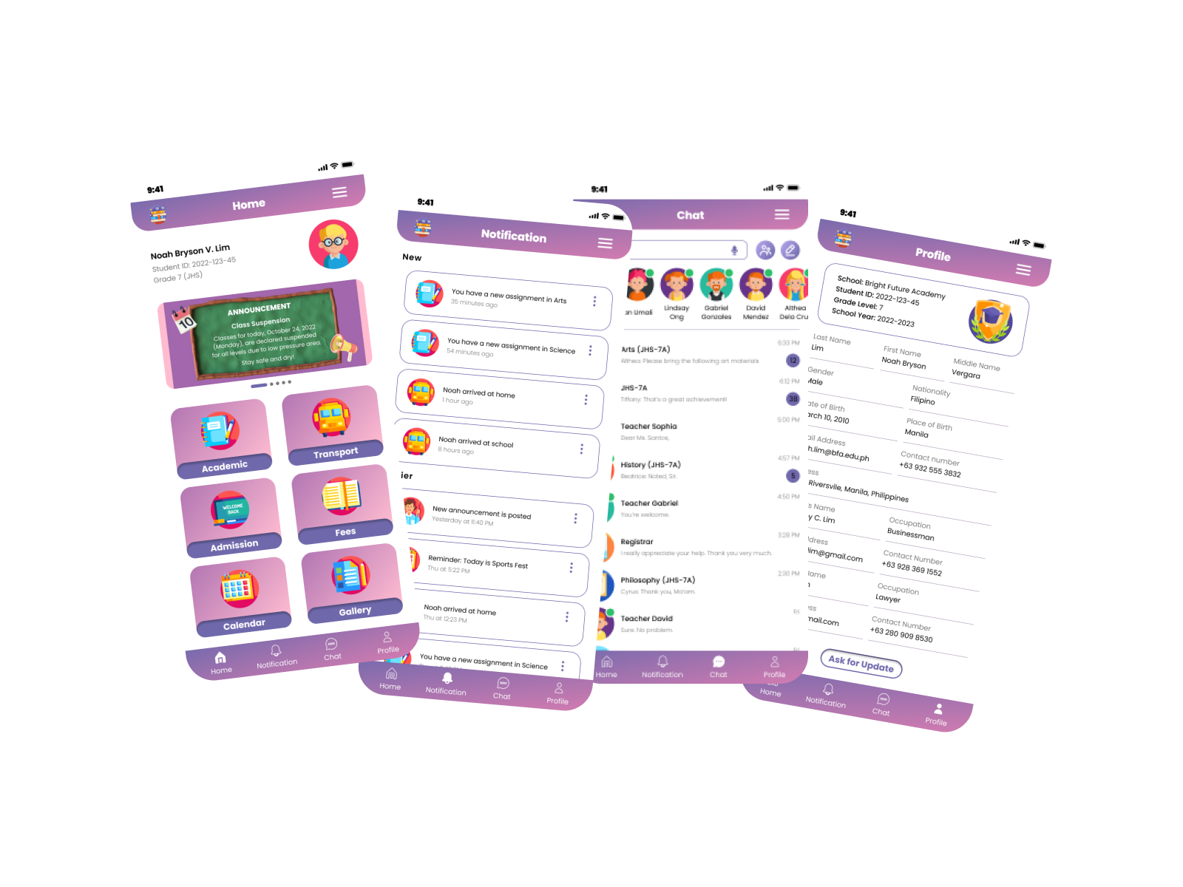
MOCKUPS
32
This is the mockups of 3Ps application. Mockup is a static wireframe that includes more stylistic and visual UI details to present a realistic model of what the application will look like.
01
02
03
04

Slide 33
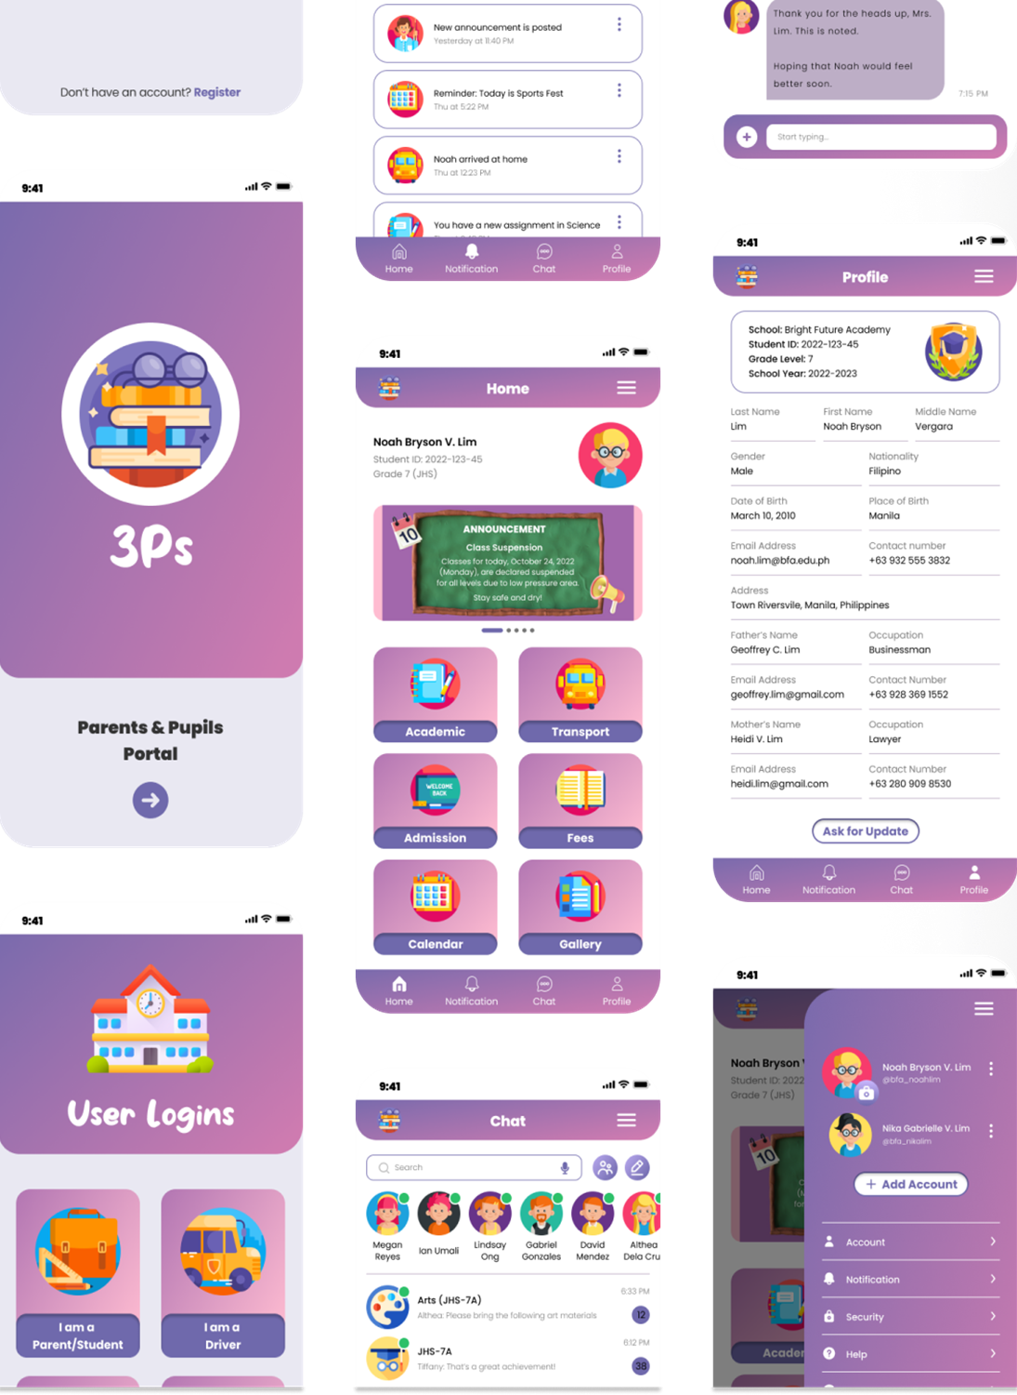
33
MOCKUPS
01
02
03
04

Slide 34
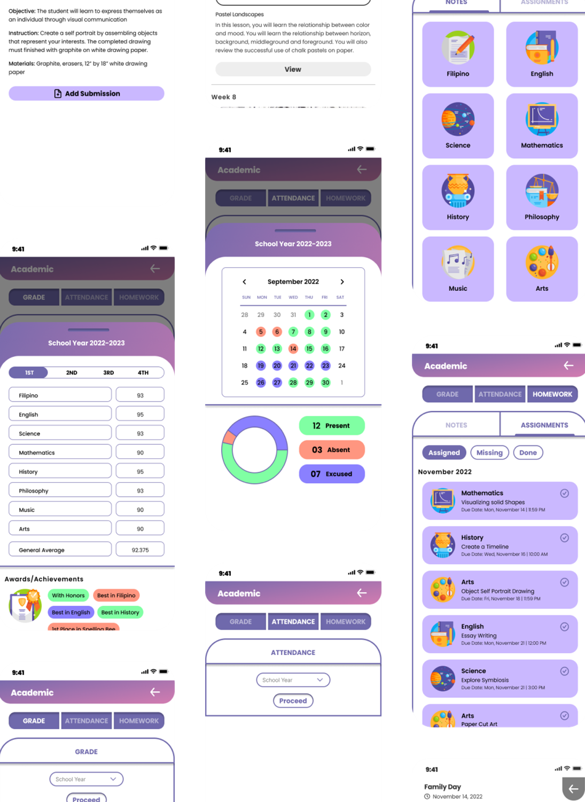
34
MOCKUPS
01
02
03
04

Slide 35
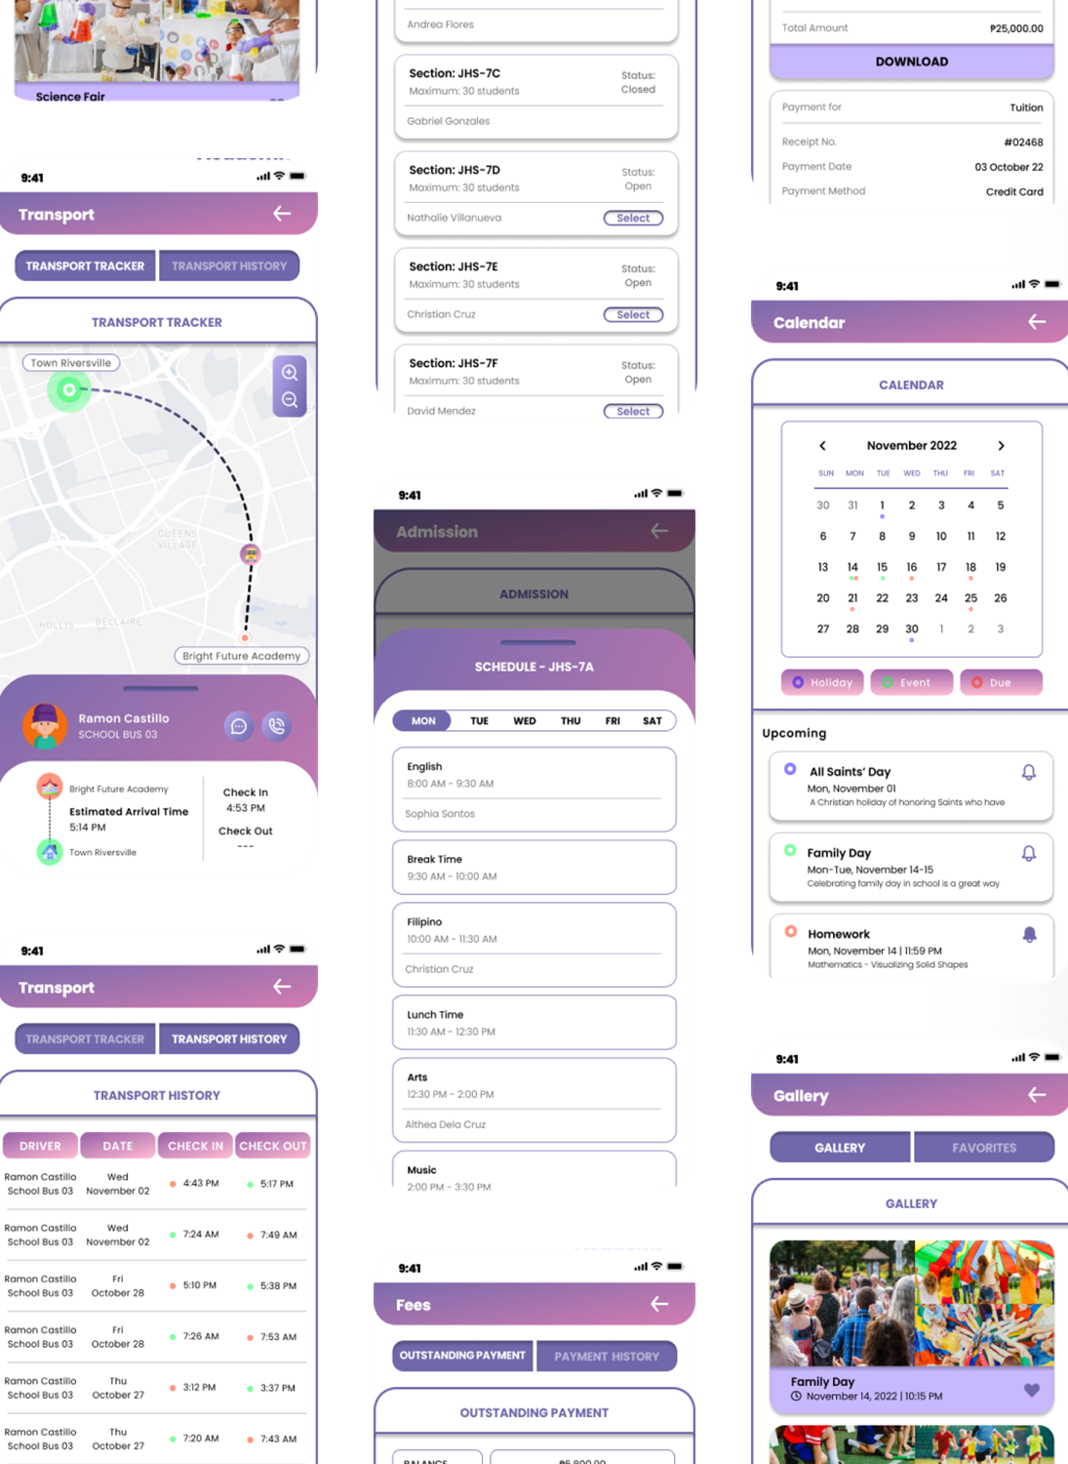
35
MOCKUPS
01
02
03
04

Slide 36
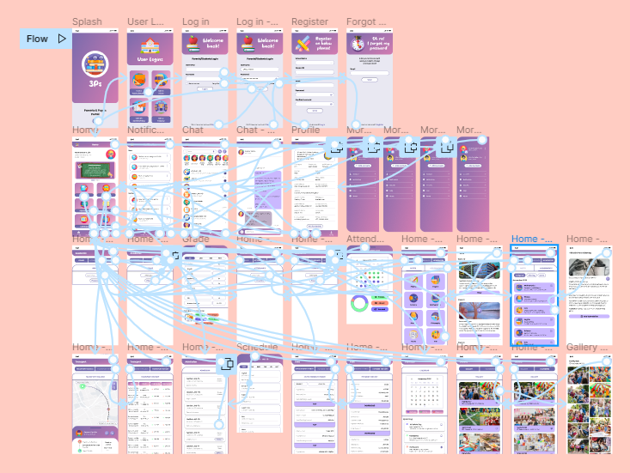
36
HIGH-FIDELITY PROTOTYPE
This is the high-fidelity prototype showing the connections between each screen. A working prototype can be tested by clicking on the link here.
01
02
03
04

Slide 37
37
ACCESSIBILITY CONSIDERATIONS
Color Contrast
Typography
I have to consider users who might be low-sighted and color-blind, so I chose color combinations that would make the texts legible.
I have to consider a font that will help the users to comfortably read the text and gives a lively feel to the application so I chose Poppins for its simpleness and it also met the criteria I am looking for a font.
Hierarchy and Layout
I have to consider the hierarchy and layout of the application so I make sure that the key information is clearly accessible and has a logical and organized structure.
01
02
03
04

Slide 38
GOING FORWARD
38
Expected Impact
Since this application has yet to be released, I am expecting that the users will give the 3Ps application favorable comments and that they will be pleased with final product.
What I Learned
This is my first project involving UX/UI design. Through this project, I have learned design concepts and developed design abilities like creating wireframes, prototypes, and mockups. In the future, I aim to learn more about the design thinking process and visual design best practices.
Next Step
I will share this project to self-promotion and social networking platforms for digital designers and creatives to gather feedbacks in order to improve and enhance my design.
01
02
03
04

Slide 39
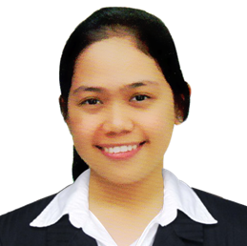





LET’S CONNECT
39
ROSH HASHANA S. TORRES
Barangay Sauyo, Quezon City
0915 266 5081
roshhashana22@gmail.com
linkedin.com/in/roshtorres
github.com/roshtorres
sites.google.com/view/roshtorres
PROFILE
CAREER OBJECTIVE
I am an enthusiastic, dedicated, motivated, reliable, responsible and hard working person. I am able to work well both in a team environment as well as using own initiative. I am adaptable to all challenging situations. I am well organized and always plan ahead to make sure I manage my time well.
To become a successful expert in the field of computer science by utilizing my technical knowledge and skills to ensure personal and professional growth and to contribute to the prosperity of the organization.
EDUCATION
CERTIFICATION
CAREER OBJECTIVE
Bachelor of Science in Computer Science
New Era University
2020-Present
Oracle Cloud Data Management 2022 Foundations Certified Associate
November 2022
Oracle Cloud Infrastructure 2022 Certified Foundations Associate
November 2022
Reactive Architecture: Introduction to Reactive Systems
October 2022
Oracle Autonomous Database Cloud 2021 Certified Specialist
November 2021
Introduction to Data Science
November 2021
SKILLS
Programming Languages: Java, HTML, R
Microsoft Office: Word, Excel, PowerPoint
Hardware Skills: Project Management, LAN Cabling, Network Configuration, Software Installation, UI Design, Wireframing, Prototyping
Advanced Computer Skills: Coding, Debugging, Web Development
Other Tools: Eclipse, IntelliJ IDEA, JFLAP, Cisco Packet Tracer, Figma, Canva, Adobe Lightroom
01
02
03
04

Slide 40




THANKS!
40
This project was created using
Figma, Flaticon, Canva, Storyboard That, and Slidesgo.
01
02
03
04

